Slide 1
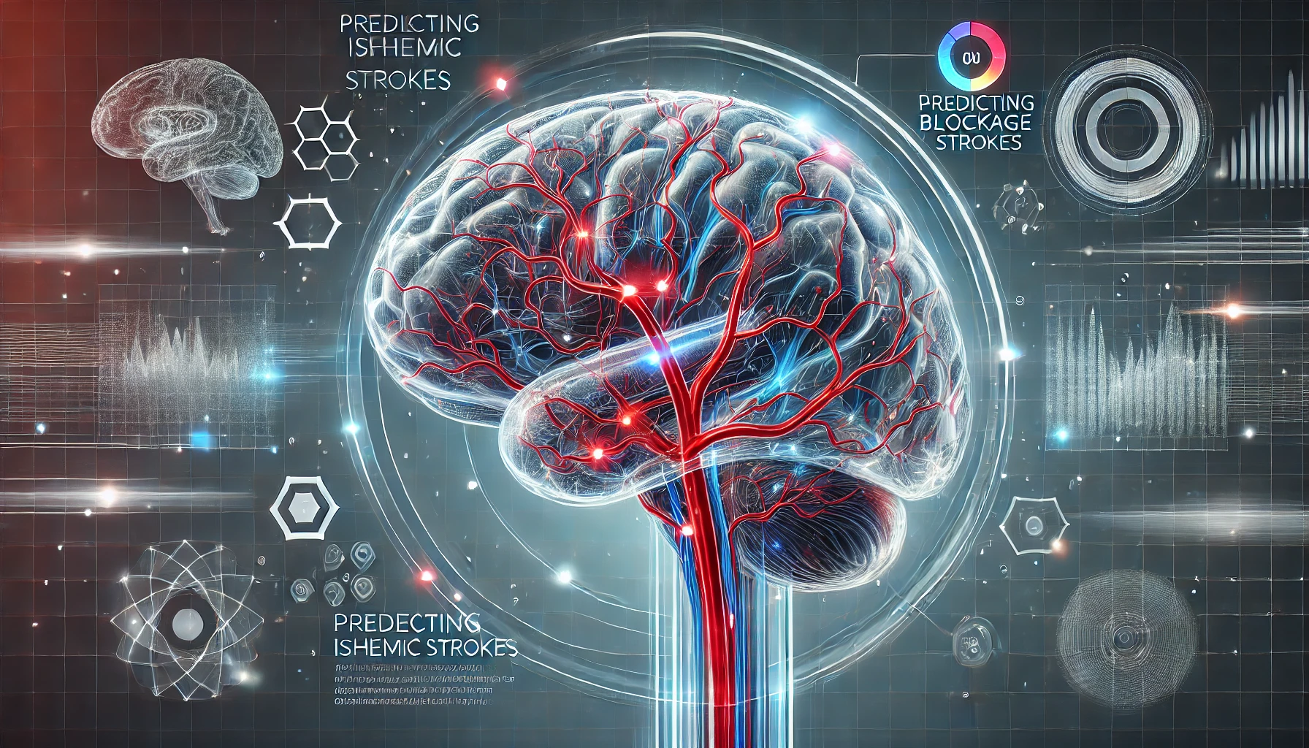
Stroke Risk Prediction
Project 2 | Team 4
Harpreet (Monty) Singh
Carolyn Scheese
Kaidon Kennedy
Danielle DeJean
Notes:
Carolyn
Imagine this scenario: An 80 year old father and grandfather, collapses while golfing and is rushed to the hospital. Despite appearing healthy, he suffers an ischemic stroke that leaves him unable to speak or walk. His life—and the lives of his loved ones—are irrevocably changed in an instant.
Now, what if we could have predicted his risk and intervened before it was too late?
We are excited to present our project on Predicting Ischemic Stroke Risk. Stroke is a leading cause of death and long-term disability worldwide, often striking without warning. Many at-risk individuals go undetected until it's too late. But we believe that with the power of artificial intelligence and machine learning, we can help change that.
In our project, we stepped into the roles of data scientists at the forefront of healthcare innovation. We worked with real-world medical datasets to develop predictive models that can identify individuals at high risk of ischemic stroke. By leveraging advanced AI techniques, we not only sharpened our technical skills but also aimed to contribute to a cause that has the potential to save lives.
Are you ready to see how AI can make a real-world impact? We'd like to share with you our journey in harnessing technology to predict and prevent one of the world's most devastating medical emergencies. Our exploration into cutting-edge AI starts now—and it could change someone's life forever.
Note: Text was generated with the help of ChatGPT

Slide 2

Project Overview & Goals
Create a model that will be the under pinning's for identifying Risk for Stroke
Create a Streamlit app prototype to predict individual risk for stroke based off major risk factors
Notes:
Carolyn-
The goal of our project is to create a model that will be the under pinning's of a Streamlit app protype that can be used to predict an individuals risk for stroke based off major risk factors.
Impact on Society, Families and the individual
Healthcare Costs:
Annual direct medical expenses in the U.S. are estimated at $34 billion.
Costs include hospital stays, medications, rehabilitation, and long-term care.
Economic Burden:
Indirect costs like lost productivity due to disability or premature death amount to an additional $16 billion annually in the U.S.
Strokes contribute to significant loss of workforce participation.
Healthcare System Strain:
High incidence rates demand substantial healthcare resources for acute care and rehabilitation.
Increased need for specialized medical professionals and facilities.
Public Health Challenge:
Stroke is a leading cause of death and disability worldwide.
Requires extensive public health initiatives for education, prevention, and improved access to care.
Impact on Families
Emotional Toll:
Family members experience distress, anxiety, and depression.
Sudden lifestyle changes can disrupt family dynamics and relationships.
Caregiving Responsibilities:
Relatives may need to become full-time caregivers.
Physical and emotional demands can lead to caregiver burnout.
Financial Strain:
Costs of medical care and rehabilitation can be overwhelming.
Potential loss of income if the survivor or caregiver cannot work.
Social Isolation:
Caregiving duties may limit social interactions.
Families might withdraw from community activities due to time constraints or emotional stress.
Impact on Individuals
Physical Disabilities:
Paralysis or weakness, often on one side of the body.
Difficulty with mobility, balance, and performing daily tasks.
Cognitive Impairments:
Challenges with memory, attention, and problem-solving skills.
May affect the ability to return to work or engage in hobbies.
Communication Challenges:
Aphasia can hinder speech and understanding language.
Frustration and isolation due to communication barriers.
Emotional and Psychological Effects:
Increased risk of depression, anxiety, and mood swings.
Emotional distress due to changes in abilities and lifestyle.
Loss of Independence:
Dependence on others for daily activities affects self-esteem.
Inability to drive, work, or live alone can diminish quality of life.
Social Relationships:
Strained relationships with friends and family.
Potential for social withdrawal due to embarrassment or frustration over limitations.
The impact of strokes is profound and multifaceted, affecting not just the individual but also their family and society at large. These challenges underscore the importance of preventive measures, early detection through predictive modeling (like our AI project), and comprehensive support systems for stroke survivors and their families. By addressing these areas, we can work towards reducing the burden of stroke and improving outcomes for everyone affected.

Slide 3
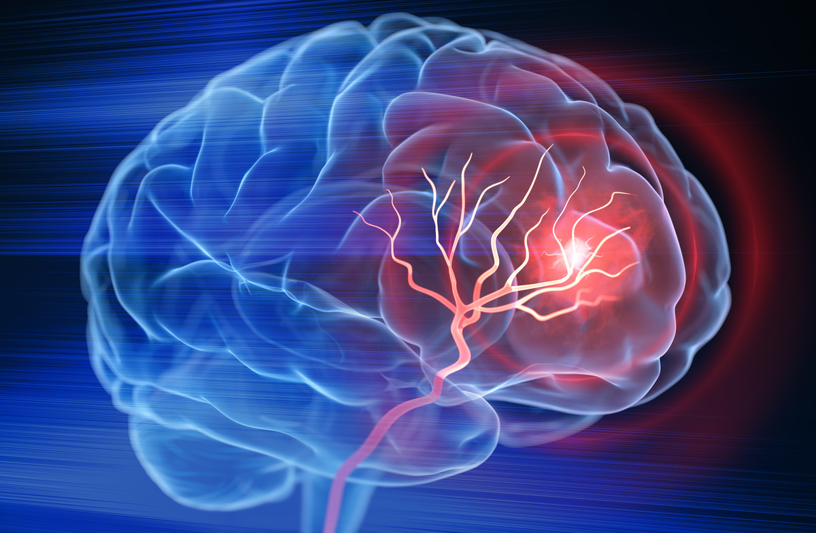
Major Risk Factors | Stroke
Modifiable
Unmodifiable
*Hypertension (High BP)
Diabetes-(*Avg Glucose Level)
*Smoking
High Cholesterol/lipids
Physical Inactivity - (*BMI > 35)
*Age; especially > 80 yrs
Race & ethnicity (black > white)
*Sex; Male > Female
Family History & Genetics
Notes:
This slide shows major stroke risk factors according to recent research. Note the * next to several factors. These are represented in the data set, but not 100% the same for example Diabetes, in the data set we have Average Glucose level. High glucose levels are a sign of diabetes. So, although this is not an exact factor, it is very similar and can probably be used successfully. The same thing is for Physical Activity….& BMI. And heart disease and high Cholesterol/ lipids.

Slide 4
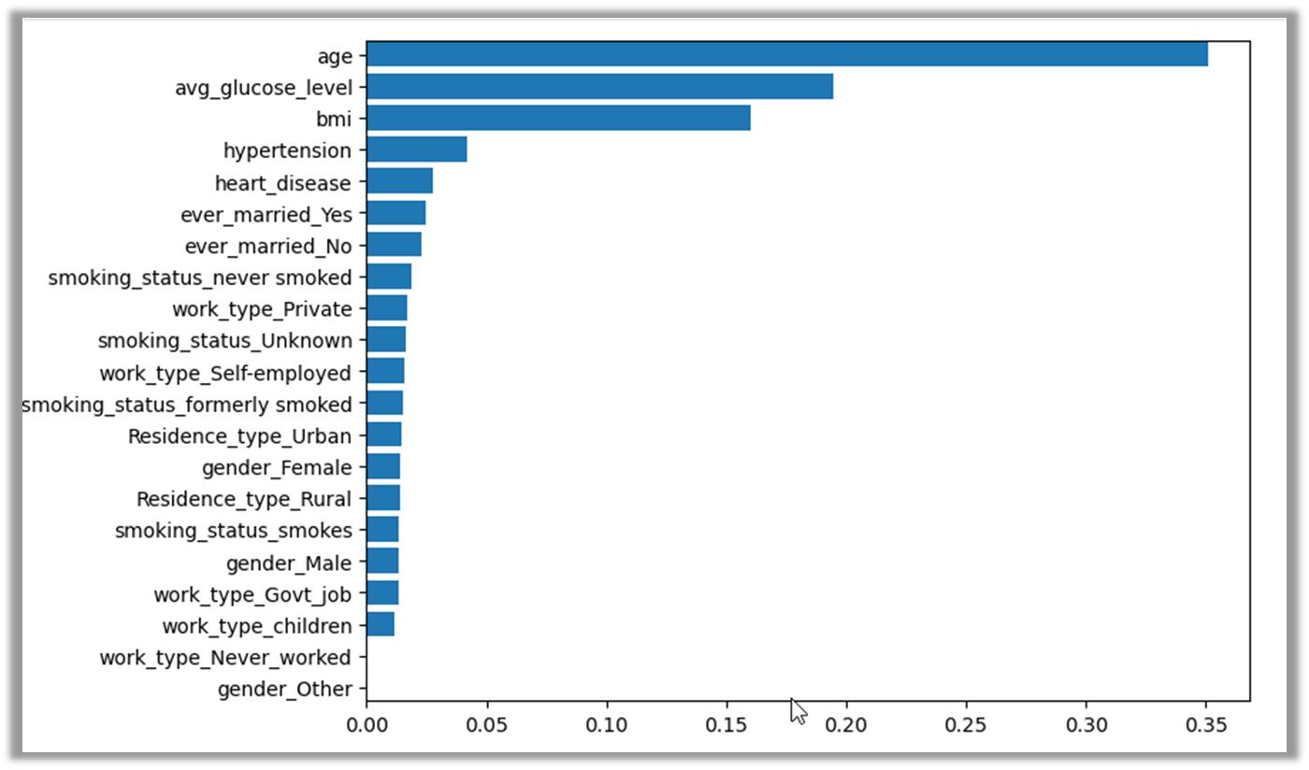
Approach to Meeting Project Goals
Kaggle.com
11 clinical features to predict stroke
Supervised Learning
Pandas, Python, Matplotlib, Pandas Plotting
Notes:
Carolyn -
Interest in predicting strokes/ or risk of stroke
Found data set on Kaggle.com
11 clinical features to predict stroke
This is a Matrix that shows the strength of each feature
Feature Importance

Slide 5
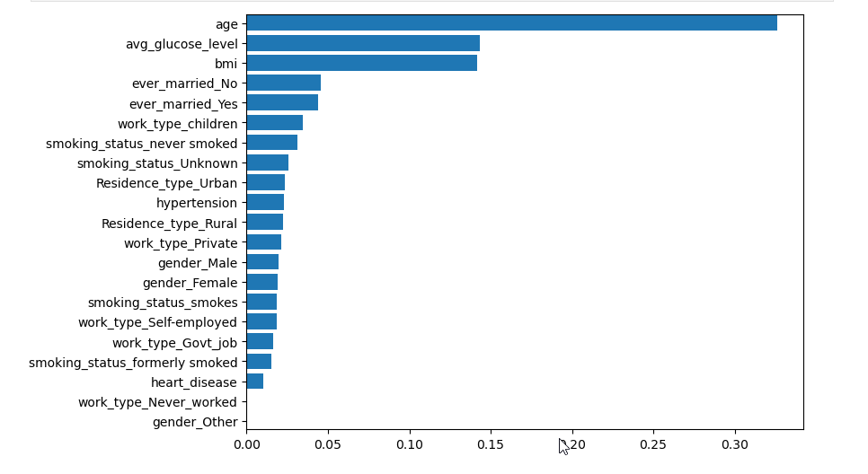
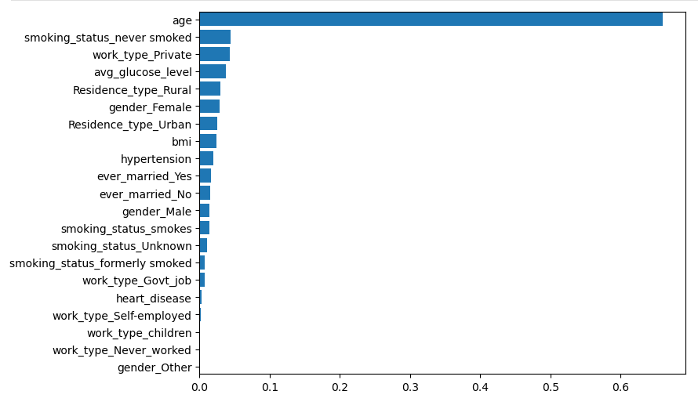
SMOTE Random Forest
Gradient Boost Classifier
SMOTE Gradient Boost
Gradient Boost
Notes:
Carolyn
These graphs show how the features of importance change with using SMOTE in conjunction of Random Forest and Gradient Boost Classifier

Slide 6

Data Collection, Exploration & Cleanup
Repo created with .gitignore / secrets.toml, for housing API keys in Streamlit
Downloaded the .csv file from Kaggle, read it into a df
5110 rows, 12 columns - only “bmi” column had NaNs
Dropped NaN rows, was left with 4909 rows - small impact, no need to fill
Copied the df and removed the y-prediction column “stroke”
Column dtypes: float64(3), int64(3), object(5)
Int: 1s and 0s we left alone
Object: OneHotEncoder
Notes:
Danielle

Slide 7
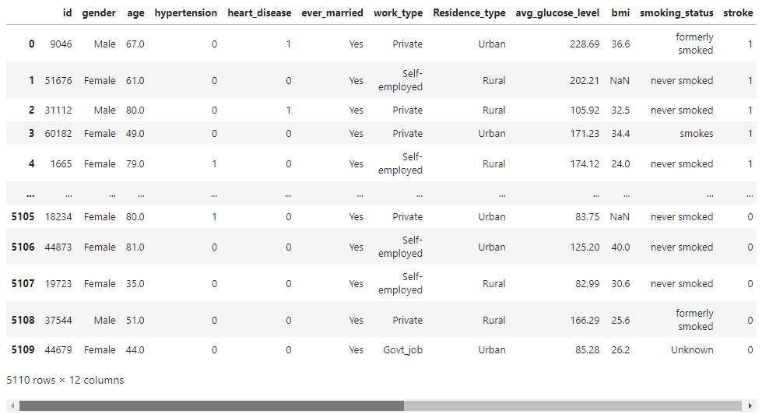
Data Collection, Exploration & Cleanup
Repo created with .gitignore / secrets.toml, for housing API keys in Streamlit
Downloaded the .csv file from Kaggle, read it into a df
Notes:
Danielle

Slide 8
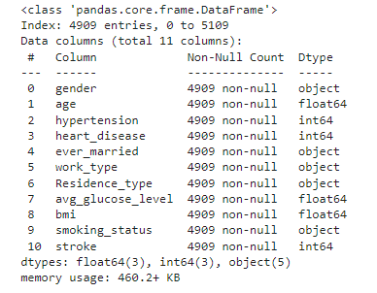
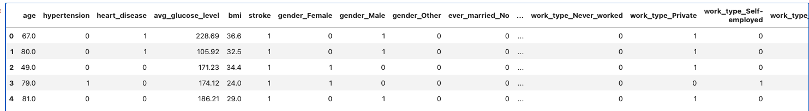
Data Collection, Exploration & Cleanup
5110 rows, 12 columns - only “bmi” column had NaNs
Dropped NaN rows, was left with 4909 rows - small impact, no need to fill
Copied the df and removed the y-prediction column “stroke”
Column dtypes: float64(3), int64(3), object(5)
Int: 1s and 0s we left alone
Object: OneHotEncoder
Notes:
Danielle

Slide 9
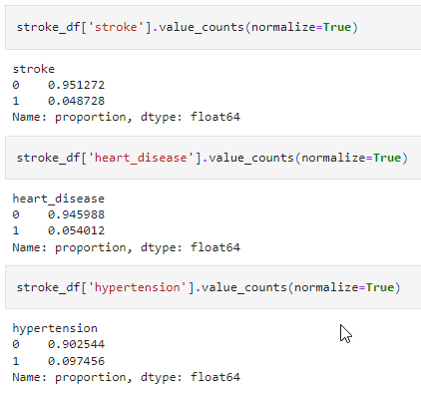
Data Collection & Exploration, & Cleanup
Train-Test split
Scaled the data (float columns)
Balanced? value_counts… NO: 0=95%
Notes:
Danielle

Slide 10

Data Collection & Exploration, & Cleanup
Ruled out oversampling - it would leave us with too little data
Ruled out SMOTEENN - wanted to address minority
Tried under-sampling: accuracy great but could not predict minority class!
SMOTE (oversampling technique, synthesizes minority data)
3717 rows, 50/50 balance
Notes:
Danielle

Slide 11
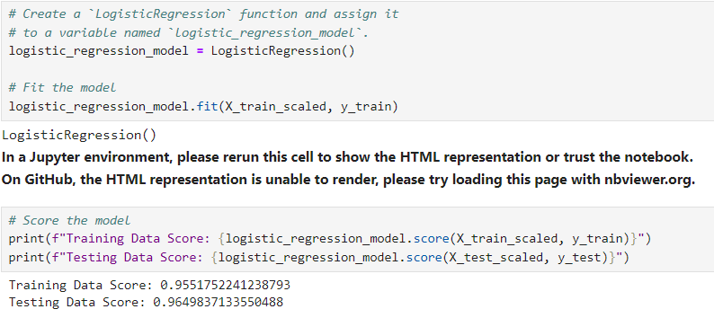
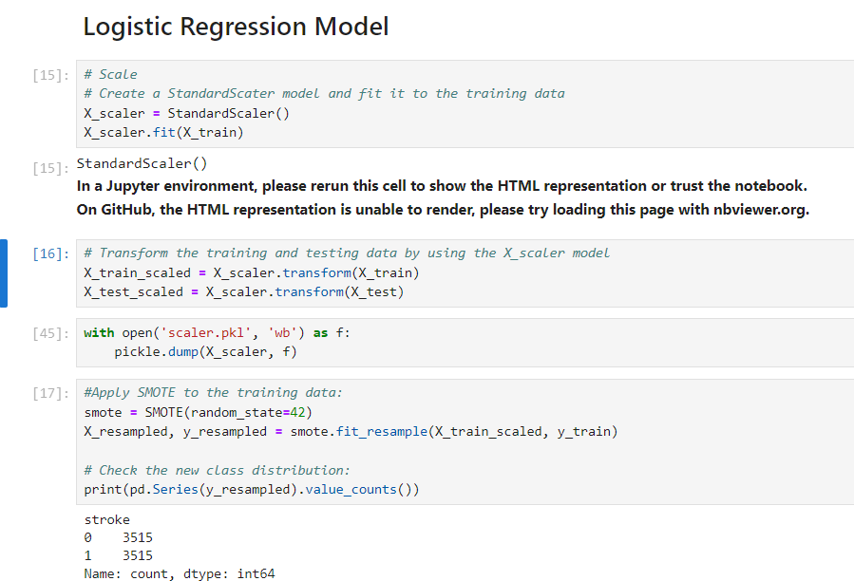
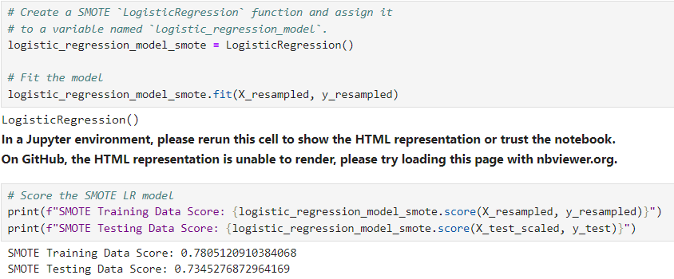
Analysis
Regular Data Score:
SMOTE Data Score:
Notes:
Monty-Hi Everyone, I am going to over some of our analysis on several of the models we decided to try out and hopefully find the ONE to use for our Streamlit app. As you can see by the screenshots here that we ran our data on the Logistics Regression Model 1st and as you can see the Accuracy Scores of both Scaled vs Smote data were pretty high but we did not feel confident enough it would be the best model to use. Lopsided on predicting “no stroke”. Very low .

Slide 12
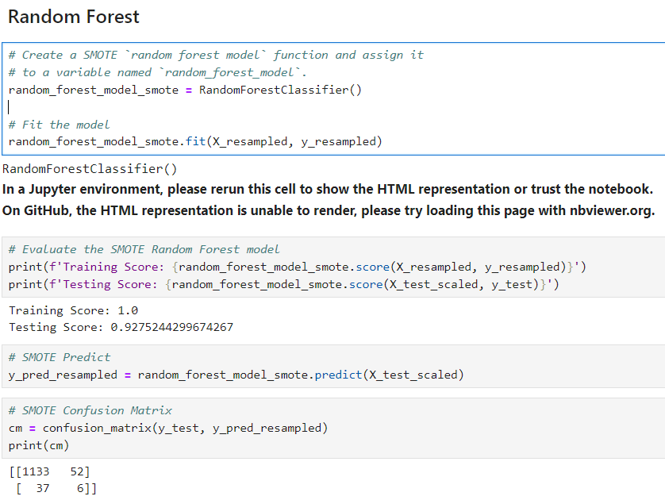
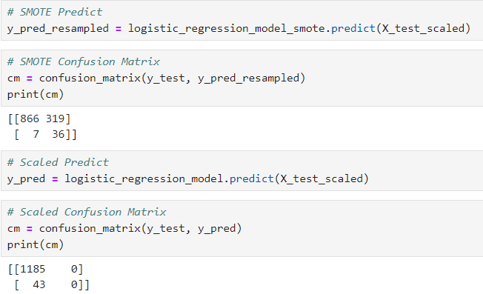
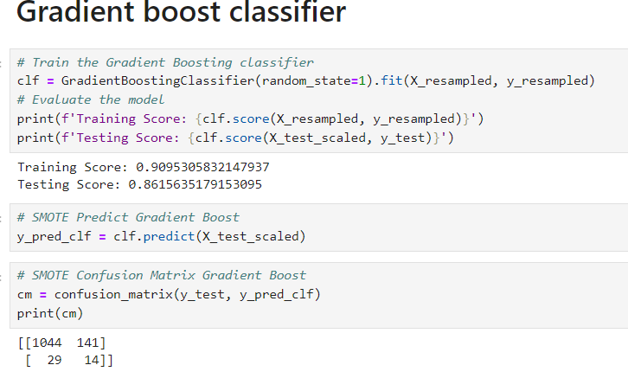
Analysis cont’d.
LR SMOTE vs. Scaled Confusion Matrix
Notes:
Monty-We ended up doing the confusion matrix on both the regular Scaled vs SMOTE and found our that both matrix predicted that we had a lopsided dataset heavily favoring one side. The 2nd model we decided to run the same scenario on was Random Forest and same thing the score was pretty nice but doing the confusion matrix showed some improvement but still lopsided. The 3rd model we used was the Gradient boost classifier as you can see in the screenshot that the confusion matrix gave us better data then the first 2 models but yet nothing we would say confidently that we are getting fair representations of actual 1s and 0s.

Slide 13
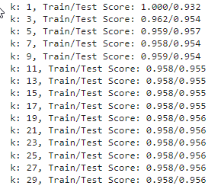
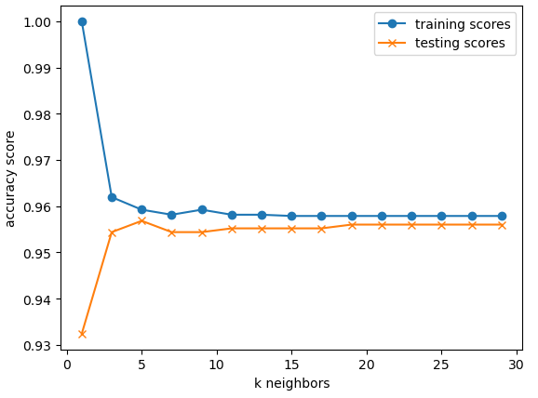
K Neighbors Classifier

Slide 14
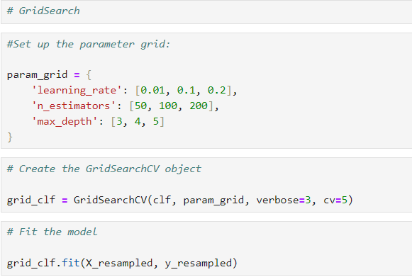
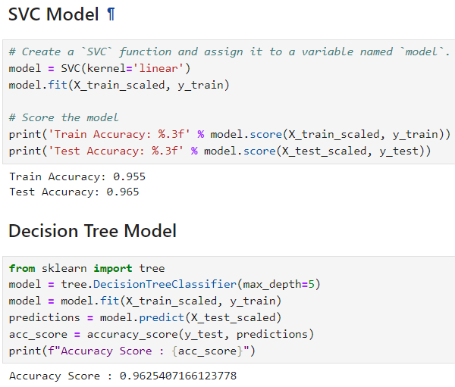
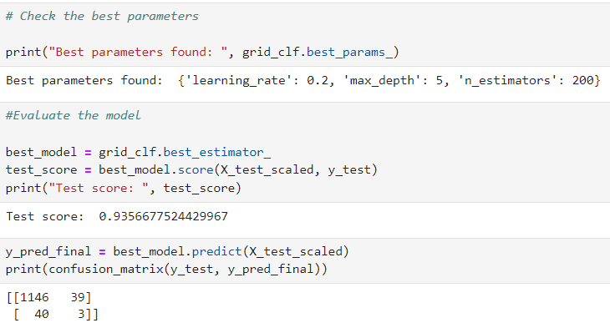
Analysis cont’d.
Grid Search – for hyperparameter tuning
Notes:
Monty-We did run other models as well as seen above but mainly were working with the previous 3. For our Streamlit app we decided to use the Gradiant Boost Classifier as it gave the best results out of the 3 models we were considering.

Slide 15
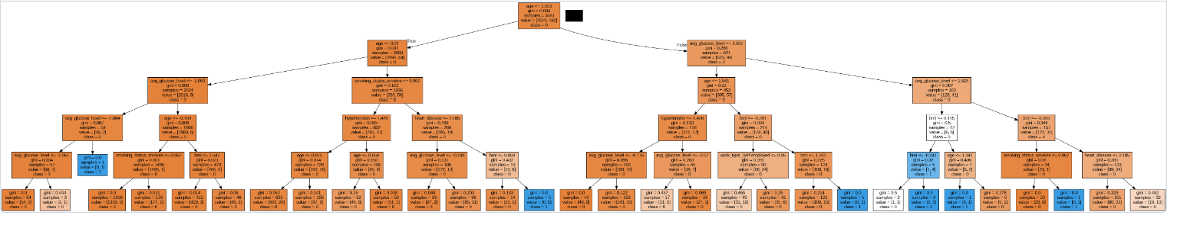
Decision Tree Model
Note: this was pre-SMOTE
Notes:
Harpreet
We ran the decision tree model and reviewed the accuracy score and then decided to go with the other model we were working on .
Here is the visual of our output.
Visually - Colors typically represent different classes and outcomes. May represent class imbalance.

Slide 16
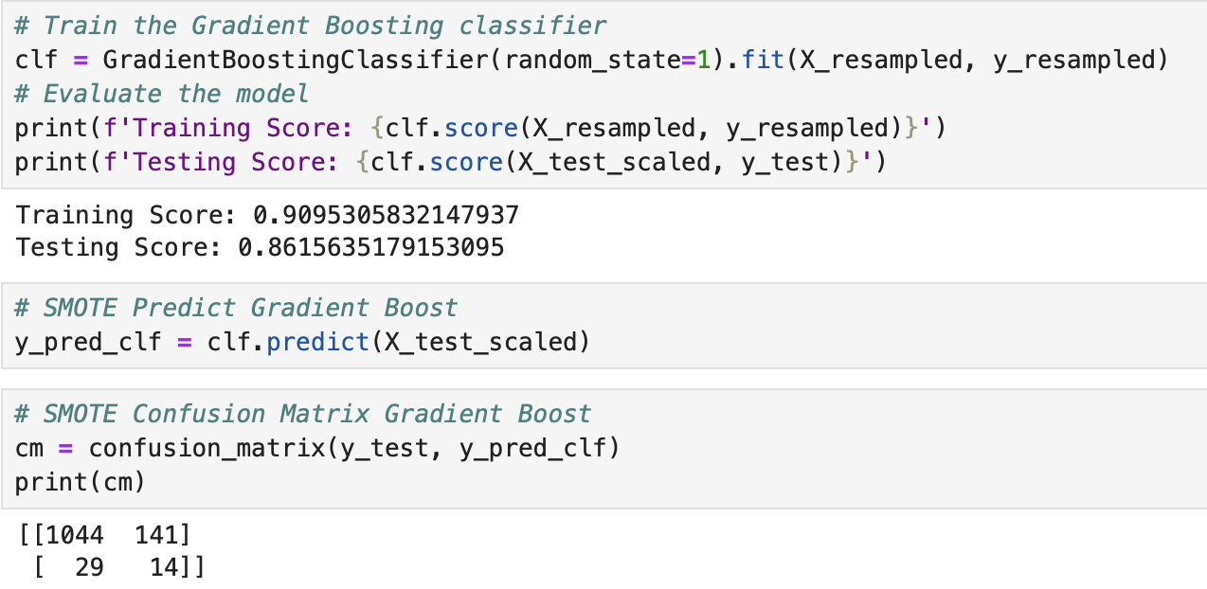
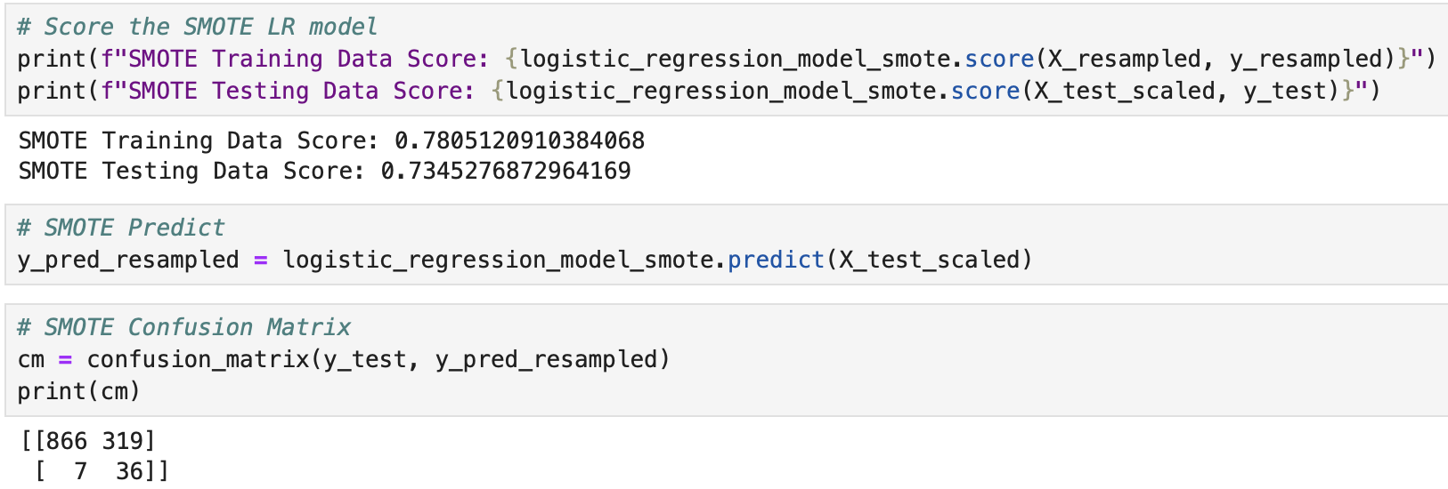
Results & Conclusions
Gradient Boost: best overall accuracy and stroke prediction
Logistic Regression: best stroke prediction, but lower accuracy
Attempt to balance the training data led to compromised model accuracy
Limited success in accurately predicting risk of a stroke
Gradient Boost Accuracy & Confusion Matrix
Logistic Regression Accuracy & Confusion Matrix
Notes:
Kaidon
In conclusion to try and predict if someone was at risk of a stroke we decided to go with the models that best represents the minority class(in this case those that were at risk of a stroke). We were not overly successful in accurately predicting if someone was at risk of a stroke. We tried to balance the training data as best as possible however it lead to compromise on the overall accuracy of the model.

Slide 17

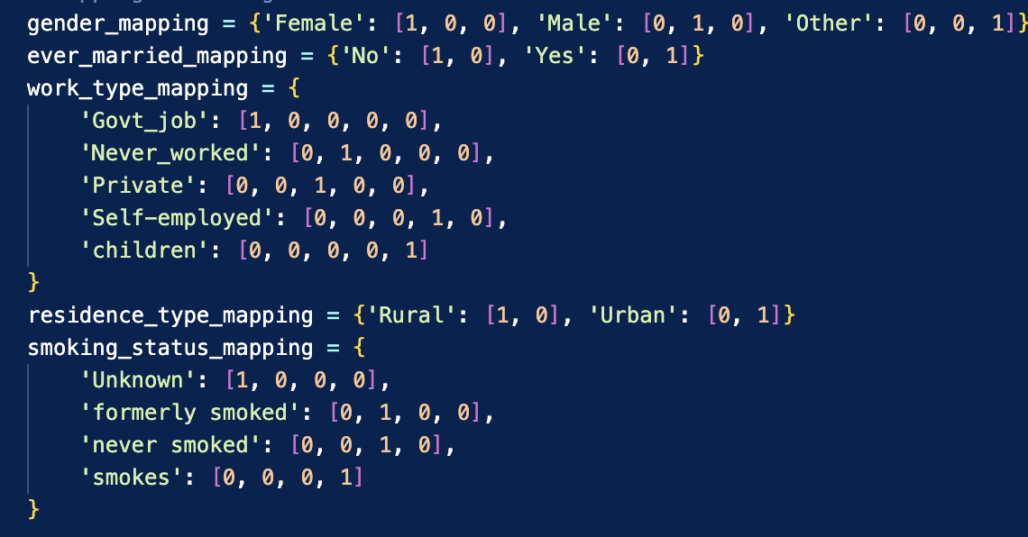
Developing an App – Stroke Risk Prediction
Built a stream lit app that was able to take in the users input to get a result on if they were at risk of a stroke.
Biggest struggle was changing features on streamlit for readability for the user while still maintaining the usability for the model. For example 1’s and 0’s to yes and no’s
Features were out of order.
Notes:
Kaidon

Slide 18
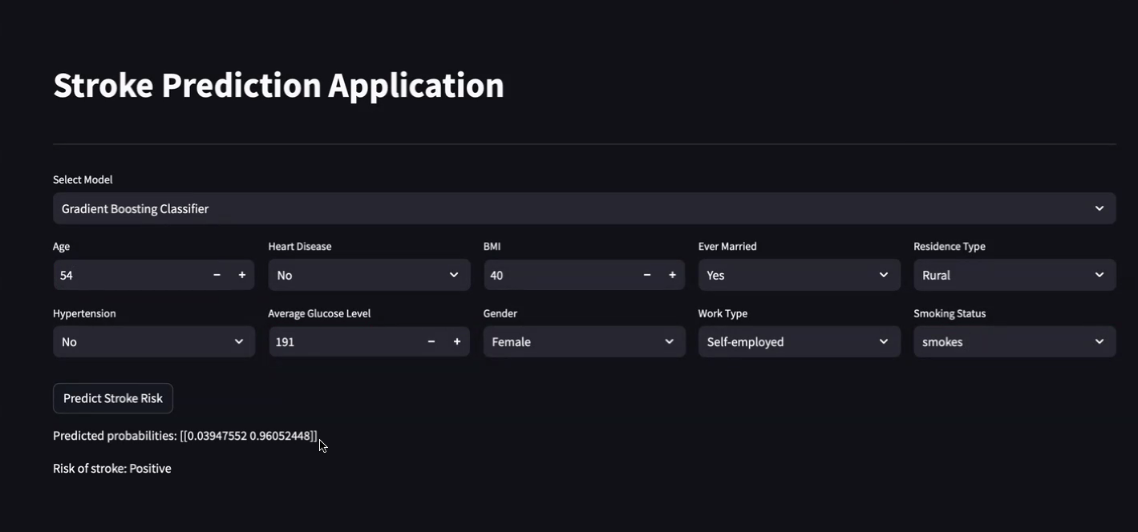
Streamlit App

Slide 19
Challenges Encountered
One of the big challenges encountered was our data was so imbalanced that every model that was trained was so accurate that it did not properly predict the minority class correctly because of what it was trained on. Hyper tuning of parameters predicted at 12%.
Resolution: We used SMOTE to help balance data
We had issues with pushing to github because of branch and .DS_Store file (Mac only) synchronization.
Resolution: The .DS file can get deleted or added to .gitignore
Printing decision tree graphic
Resolution: We were able to print it using Google Colab
We had problems representing binary data as user input in Streamlit app
Resolution: Mapping for categorical features to numeric values
Getting the Streamlit app to properly predict Stroke Risk
Resolution: needed proper sequencing of features (columns)
Notes:
Carolyn

Slide 20
If We Had More Time……Next Steps
Remove one of the gender columns & urban/rural columns
Remove columns that were not top 5 on feature importance
Create an unsupervised model by predicting on a different variable
Conduct a usability study:
“Try out” the prototype app with small focus groups
Because the data was unbalanced, we would look for additional data sets that are more balanced
Notes:
Carolyn

Slide 21
References
Data Source. https://www.kaggle.com/datasets/fedesoriano/stroke-prediction-dataset
UpToDate. (2024). Overview of Secondary Prevention of Ischemic Stroke. https://www-uptodate-com.ezproxy.lib.utah.edu/contents/overview-of-secondary-prevention-of-ischemic-stroke?search=stroke%20risk%20factors&source=search_result&selectedTitle=1%7E150&usage_type=default&display_rank=1
UpToDate. (2024). Overview of Secondary Prevention of Ischemic Stroke. https://www-uptodate-com.ezproxy.lib.utah.edu/contents/overview-of-secondary-prevention-of-ischemic-stroke?search=stroke%20risk%20factors&source=search_result&selectedTitle=1%7E150&usage_type=default&display_rank=1
WHO. (2024). Mean Fasting Blood Glucose. https://www.who.int/data/gho/indicator-metadata-registry/imr-details/2380#:~:text=The%20expected%20values%20for%20normal,and%20monitoring%20glycemia%20are%20recommended
Northcott S, Moss B, Harrison K, Hilari K. A systematic review of the impact of stroke on social support and social networks: associated factors and patterns of change. Clinical Rehabilitation. 2016;30(8):811-831. doi:10.1177/0269215515602136
Notes:
1.
Northcott S, Moss B, Harrison K, Hilari K. A systematic review of the impact of stroke on social support and social networks: associated factors and patterns of change. Clinical Rehabilitation. 2016;30(8):811-831. doi:10.1177/0269215515602136

Slide 22
Questions?

